Slide 1
Should Robots that do People’s Jobs Pay Taxes?
BY: Nirgun Amin

Slide 2

Course of Action
PROPOSITION: If a company uses a robot to do a job that a person could do, then the company should pay taxes on the equivalent of the wages that the person who would have done that job should earn.
Notes:
In addition, this positive statement could illustrate the Impact on employment and taxes: Both employment and tax revenue will suffer significantly if robots are used in place of human workers. There will be fewer people paying taxes on their wages as robots replace workers, resulting in less tax revenue for governments.

Slide 3
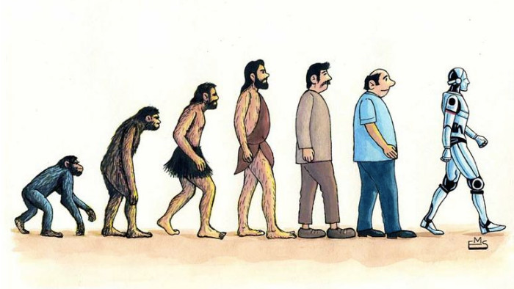
Argument Reasoning
Many companies are using robots to do jobs that used to be done by people, often to cut costs.
If people did these jobs they would have to pay taxes. If robots do these jobs, the company may pay a different tax rate on any additional profit gained by using the robots.
These taxes may not offset the lost taxes from not paying the worker. These additional taxes could be used by the government to assist workers who have diminished earnings or are unable to find work.
Notes:
1)Relating the argument to the course of action as many companies are using robots to replace human workers, they are often doing so in order to reduce labor costs.
2)However, if these jobs were performed by people, the company would be required to pay taxes on the wages earned by those workers.
3)When robots are used instead, the company may not pay the same taxes as they would if a human were doing the job. This can result in lost tax revenue for the government. By implementing additional taxes on companies that use robots, the government can offset some of this lost revenue and use the funds to support workers who have lost their jobs or are struggling to find work. This approach could help to balance the benefits of automation for companies with the need to ensure that everyone in society benefits from technological progress.

Slide 4

Con Side
Con: Taxing robots discourages productivity growth.
The entire purpose of these robots is to speed up productivity and increase profits.
Taxing robots and the automation they allow for, completely defeats the purpose of using robots, discouraging companies from automating processes.
In a study done by Georg Graetz and Guy Michaels, they found that increasing the number of robots ended up increasing labor productivity and GDP.
With the incorporation of a robot tax, companies would be deterred from automating menial tasks, and end up slowing down the country’s progression and innovation.
Notes:
1)In this slide, I included one negative example. This is an example where it states that taxing robots discourages productivity growth, but it's important to balance the need to encourage productivity growth with the responsibility to ensure that everyone benefits from technological progress. By implementing taxes on companies that use robots, the government can incentivize innovation and support workers who have been negatively affected by automation. This can help to ensure that everyone benefits from increased productivity and economic growth in the long run.

Slide 5
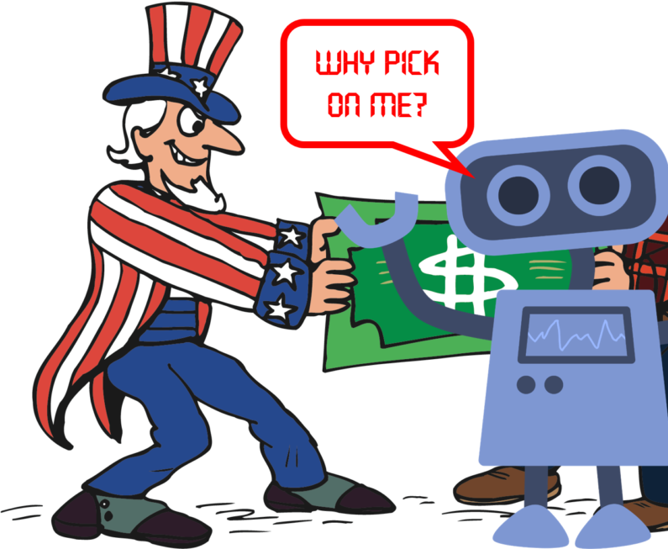
Pro: Taxes prevents companies from using robots for every task, which could lead to employment of humans.
Taxing robots to prevent companies from using them to create more human employment is not a solid plan. Robots are complements to labor, not substitutes for labor in most cases.
For example, Amazon has been increasing the number of robots it uses in its fulfillment centers, but Amazon has also been increasing the number of humans it employs in its fulfillment centers.
The fear of robots lowering jobs for humans is flawed, and can be dangerous because it can hinder new technological innovations that can bring new jobs.
Notes:
This rebuttal is to support the con slide, Taxing robots in order to prevent companies from using them to create more jobs for humans may not be an effective plan. In fact, robots often complement human labor rather than replace it. For instance, Amazon has increased its use of robots in its fulfillment centers while also increasing the number of human employees in those centers. Therefore, fears that robots will lead to job losses for humans are flawed and could even be dangerous, as they may impede new technological innovations that could bring about new job opportunities. Ultimately, taxing robots to prevent job losses may not be a good plan, as robots can actually create new jobs and boost economic growth.

Slide 6
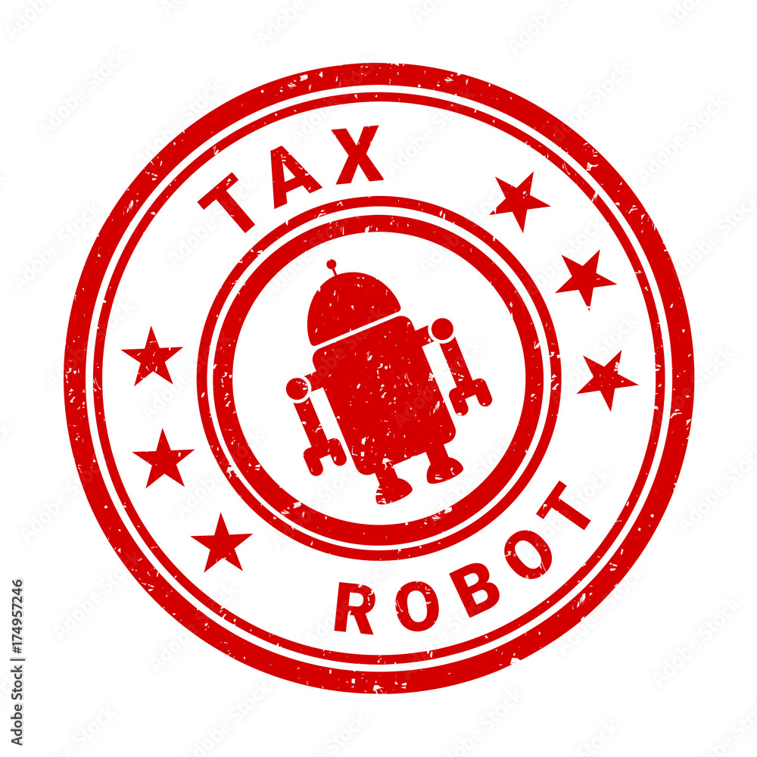
CONCLUSION
Forcing companies to pay for taxes on robots has multiple benefits that will help the people.
It can help restore some of the economic damages that the robots caused. Taxing robots will helps us achieve a universal basic income that will benefit everyone. Taxing robots also slows down the rate of unemployment and helps some of the employees keep their jobs.
Robot taxes will help prevent an overall tax increase due to the declining employment rate, by taxing robots it helps lower taxes for people. It also slows down companies from replacing the human workforce with robots. A vote for robot taxes is a step towards economic recovery.
Notes:
1)In conclusion, implementing taxes on robots can provide multiple benefits that help people.
2)Firstly, it can help to restore some of the economic damages caused by robots. Additionally, robot taxes can help to achieve a universal basic income that benefits everyone, while also slowing down the rate of unemployment and helping some employees to keep their jobs.
3)By taxing robots, we can prevent an overall tax increase due to the declining employment rate, and even lower taxes for people.
4)Furthermore, it can slow down companies from replacing human workers with robots, ensuring that everyone benefits from technological progress. Therefore, a vote for robot taxes is a crucial step towards economic recovery and ensuring that everyone can benefit from the advancements in technology.

Slide 7


